Slide 1

STORES SALES PREDICTION
Somay mangla

Slide 2
INTRODUCTION
Store Sales Prediction is the process of using a company’s sales records over the past years to predict the short-term or long-term sales performance of that company in the future. This is one of the pillars of proper financial planning. As with any prediction-related process, risk and uncertainty are unavoidable in Sales Forecasting too.

Slide 3
OBJECTIVE
The objective is to build a predictive model and find out the sales of each product at a particular store. Big Mart will use this model to understand the properties of products and stores which play a key role in increasing sales.

Slide 4
ARCHITECTURE
Import Libraries
Data Reading
Check null value and fill that value
EDA using Klib
Standardization
Label Encoding
Preprocessing
EDA using Pandas Profiling
Model Building
Deployment using flask
Application start
Data from user
Final Outcome

Slide 5
Dataset
1 Item Weight 2. Item Fat Content
3. Item Visibility 4. Item Type
5. Item Mrp 6. Outlet Year
7. Outlet Size 8. Outlet Location
9. Outlet Type 10. Outlet Supply

Slide 6
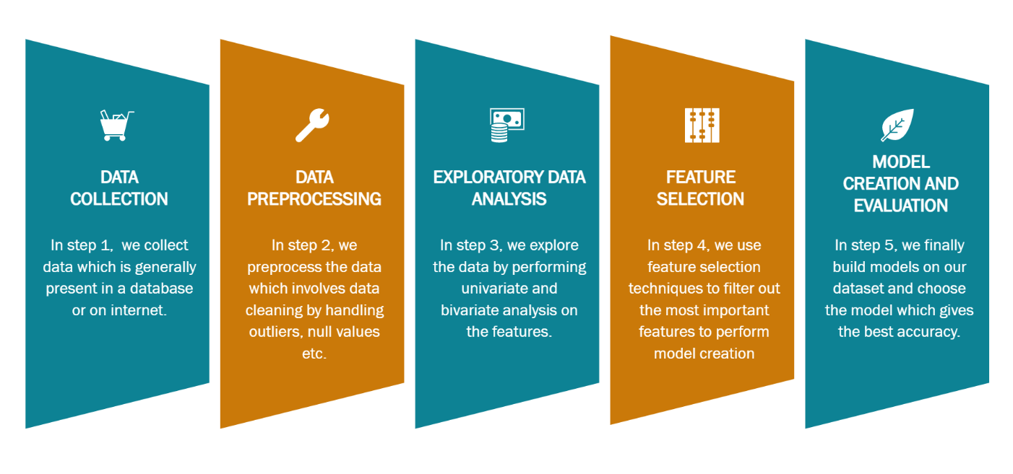
Data Analysis Step

Slide 7
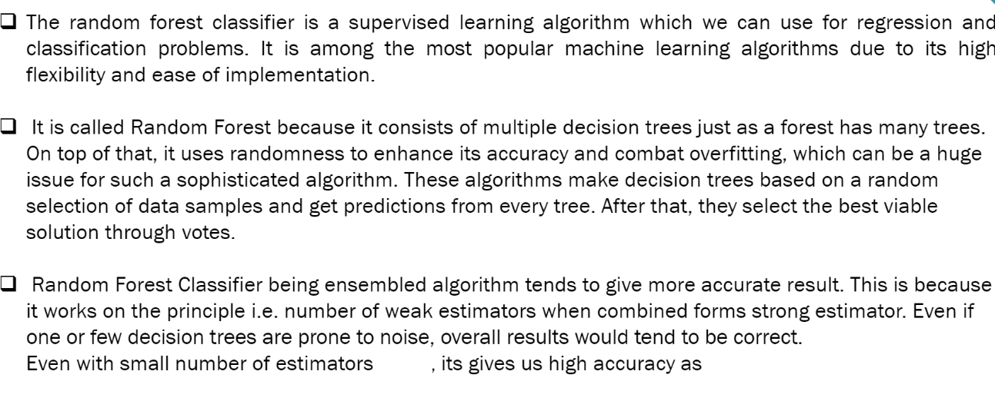
Random Forest Model
1000
80

Slide 8
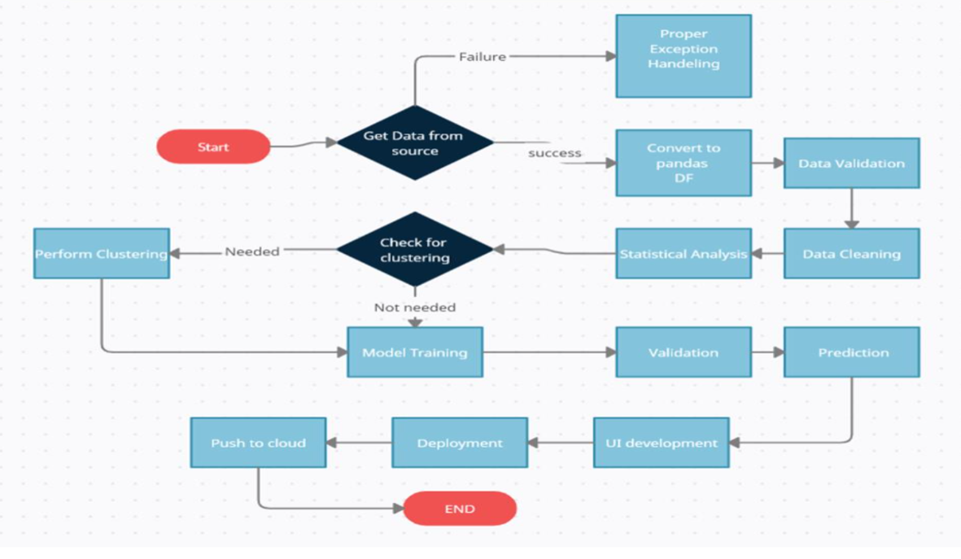
Model Training and Workflow

Slide 9
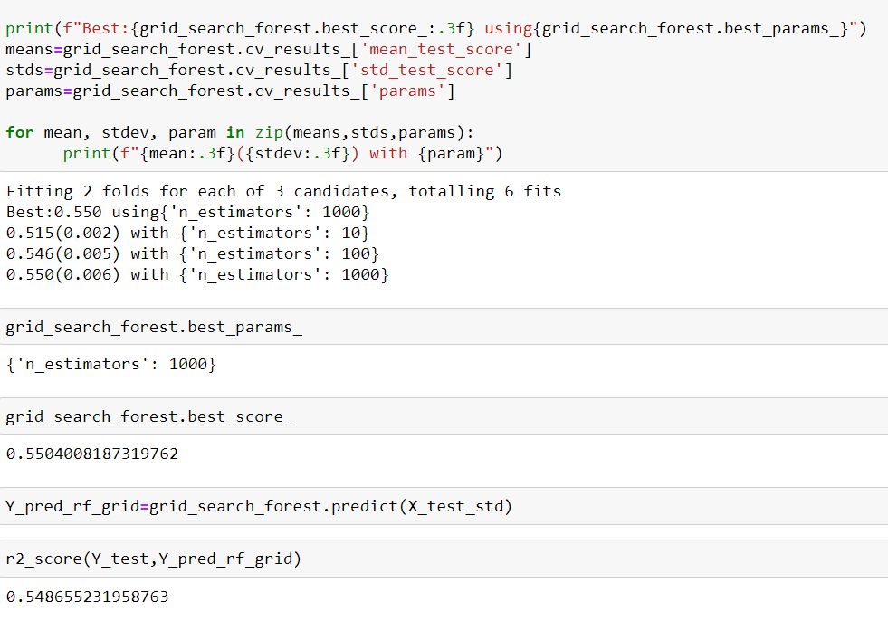
Model Predicting Result On Test Dataset

Slide 10




Deployment and IDE
The Final Deployment or web page is deployed by flask and html Framework

